Slide 1
SOGIESC Workshop
Christian James E. Barimbao
January 31, 2024
Video and Image Processing Laboratory
Main reference: https://rainbowresearchhub.up.edu.ph/resources/

Slide 2
Ano ang iyong uri?
What is your sex?

Slide 3
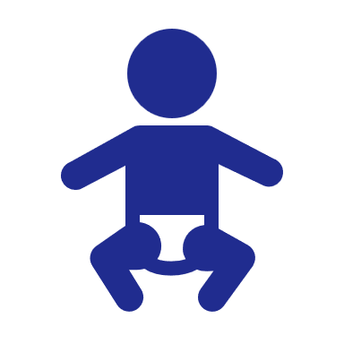



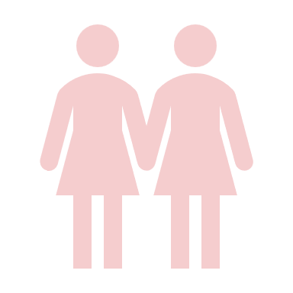
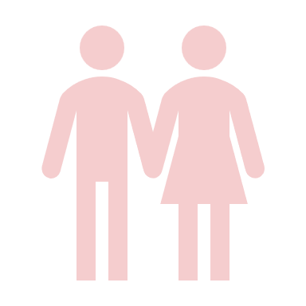
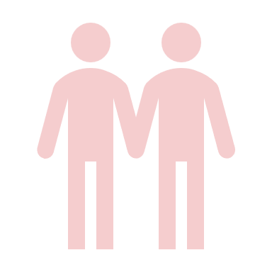
SoGIEsC (Sex Characteristics)
INTERSEX
used to be called
Hermaphrodite, this is now outdated
FEMALE
(XX chromosomes, vagina, ovaries,
higher levels of estrogen and progesterone, etc.)
MALE
(XY chromosomes, penis, testes,
higher levels of testosterone, etc.)

Slide 4
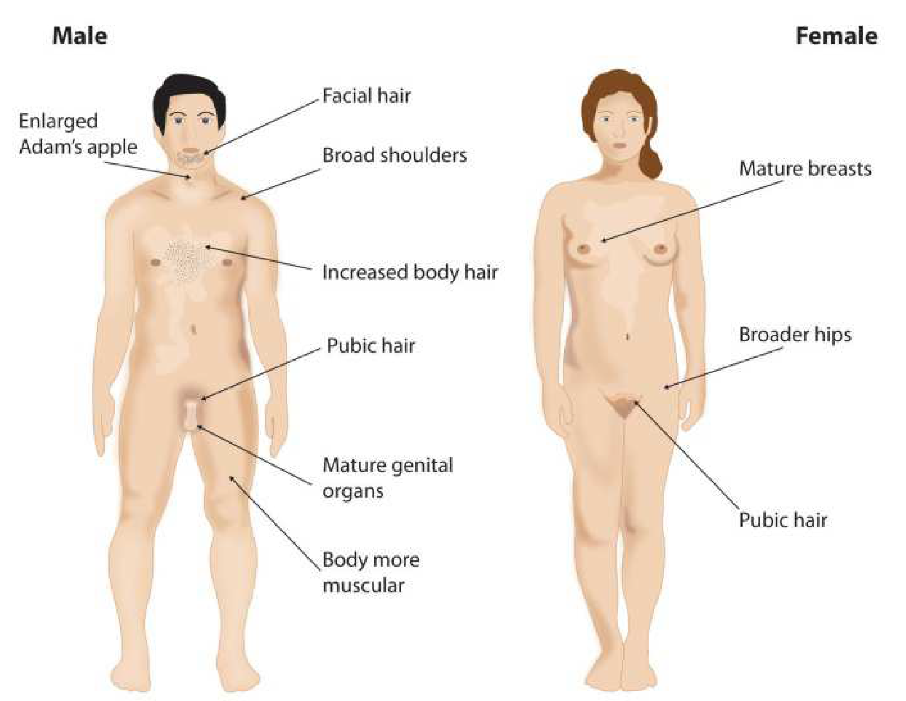
SoGIEsC (Sex Characteristics)
© UP CWGS SOGIESC Primer (2022)

Slide 5
SoGIEsC (Sex Characteristics)
Anatomical distinctions of biological sex.
Can be categorized to primary (reproductive) or secondary characteristics (develops at maturity).
© UP CWGS SOGIESC Primer (2022)

Slide 6
Ano ka?
What are you?

Slide 7
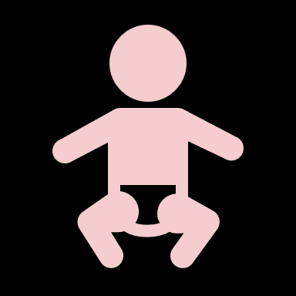



SoGIEsC (Gender identity, and Gender expression)
Sex VS Gender:
Gender is a social construct.
Sex
Male
Female
Intersex
Gender
Man
Woman
Other Genders

Slide 8
SoGIEsC (Gender identity, and Gender expression)
Some adjectives to describe gender:
Gender norms
Gender
Identity
Assigned Sex at Birth
Cisgender
Transgender

Slide 9
SoGIEsC (Gender identity, and Gender expression)
Some adjectives to describe gender:
Cisgender
Transgender
Queer
Gender norms
Gender
Identity
Assigned Sex at Birth

Slide 10
SoGIEsC (Gender identity, and Gender expression)
Some adjectives to describe gender:
Cisgender
Transgender
Queer
Gender norms
Gender norms
Gender
Identity
Assigned Sex at Birth
Opposite Sex

Slide 11
SoGIEsC (Gender identity, and Gender expression)
Some adjectives to describe gender:
Cisgender
Transgender
Queer
Gender norms
Gender norms
Assigned Sex at Birth
Opposite Sex
Gender
Identity

Slide 12
SoGIEsC (Gender identity, and Gender expression)
Some adjectives to describe gender:
Cisgender
Transgender
Queer
Agender
Bigender
Non-binary
Genderfluid
Two-spirit
Babaylan / Katalonan
Gender norms
Gender norms
Assigned Sex at Birth
Opposite Sex
Gender
Identity
Notes:
Two-Spirit (Various Indigenous Tribes in North America): The term "Two-Spirit" is often used by some Indigenous tribes in North America to describe a person who embodies both masculine and feminine qualities or occupies a gender role outside the traditional binary. The specific roles and responsibilities associated with Two-Spirit individuals can vary among tribes.
Hijra (South Asia): While not specific to indigenous tribes, the Hijra community in South Asia has existed for centuries. Hijras are considered a third gender in South Asian cultures, encompassing individuals who may be intersex, transgender, eunuchs, or simply not conforming to the binary gender system.
Fa'afafine (Samoa): In Samoan culture, the term "fa'afafine" refers to individuals who identify outside the traditional male/female binary. Fa'afafine are recognized and accepted as a distinct gender category with roles and responsibilities in Samoan society.
Berdache (Various Indigenous Tribes): The term "berdache" has been historically used by anthropologists to describe gender-diverse individuals in some Indigenous tribes. However, its use has been criticized, and many prefer the term Two-Spirit for more accurate and culturally respectful representation.

Slide 13
Ano ang gusto mong suotin?
What do you like to wear?

Slide 14
SoGIEsC (Gender identity, and Gender expression)
Neutral
Androgynous
Queer
Non-Conforming
Womanly/
Feminine
Male/
Masculine
How others perceive us
Notes:
Two-Spirit (Various Indigenous Tribes in North America): The term "Two-Spirit" is often used by some Indigenous tribes in North America to describe a person who embodies both masculine and feminine qualities or occupies a gender role outside the traditional binary. The specific roles and responsibilities associated with Two-Spirit individuals can vary among tribes.
Hijra (South Asia): While not specific to indigenous tribes, the Hijra community in South Asia has existed for centuries. Hijras are considered a third gender in South Asian cultures, encompassing individuals who may be intersex, transgender, eunuchs, or simply not conforming to the binary gender system.
Fa'afafine (Samoa): In Samoan culture, the term "fa'afafine" refers to individuals who identify outside the traditional male/female binary. Fa'afafine are recognized and accepted as a distinct gender category with roles and responsibilities in Samoan society.
Berdache (Various Indigenous Tribes): The term "berdache" has been historically used by anthropologists to describe gender-diverse individuals in some Indigenous tribes. However, its use has been criticized, and many prefer the term Two-Spirit for more accurate and culturally respectful representation.

Slide 15
Kanino ka nagkakagusto?
To whom are you attracted to?

Slide 16
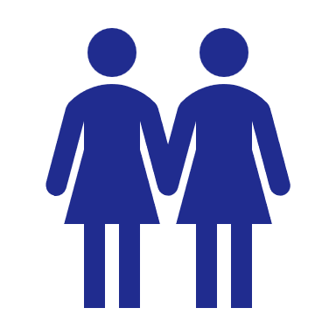
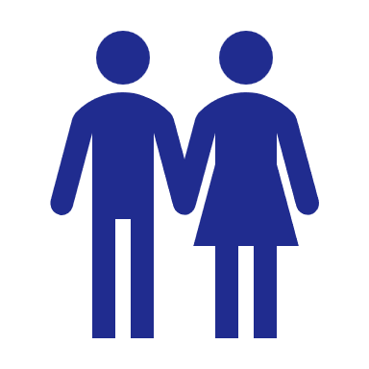
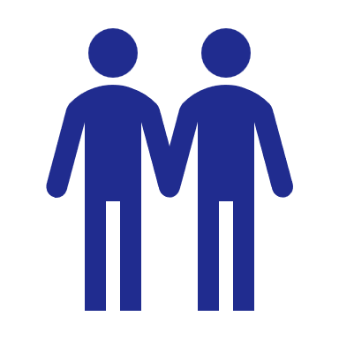
SoGIEsC (Sexual orientation)
Level of attraction
Same gender
(Homosexual)
No attraction
(Asexual)
Different gender
(Heterosexual)
Bisexual+

Slide 17
To SUMMARize
What is your sex? (SC)
What are you? (GI)
What do you like to wear? (GE)
To whom are you attracted to? (SO)

Slide 18
THANK YOU!

